Slide 1
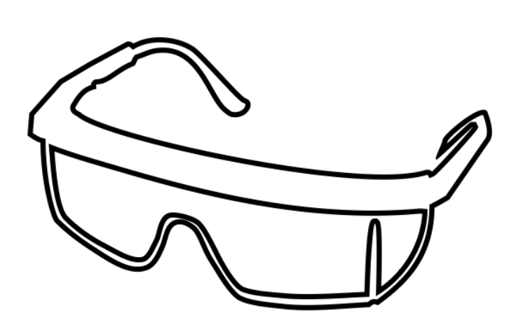
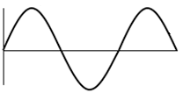
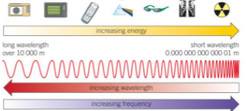
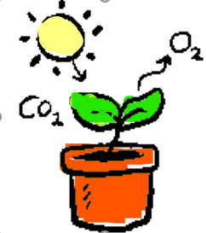
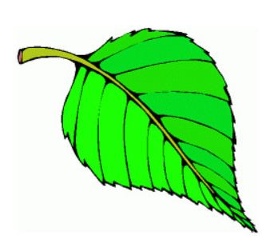
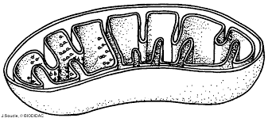
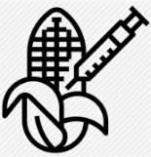
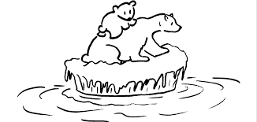
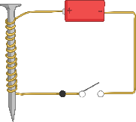
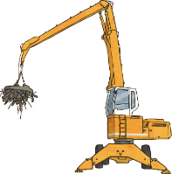
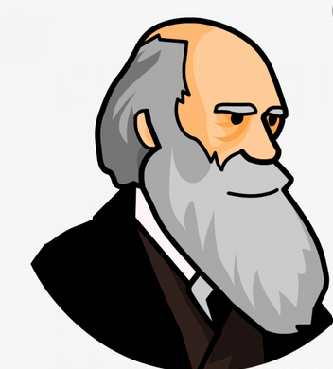
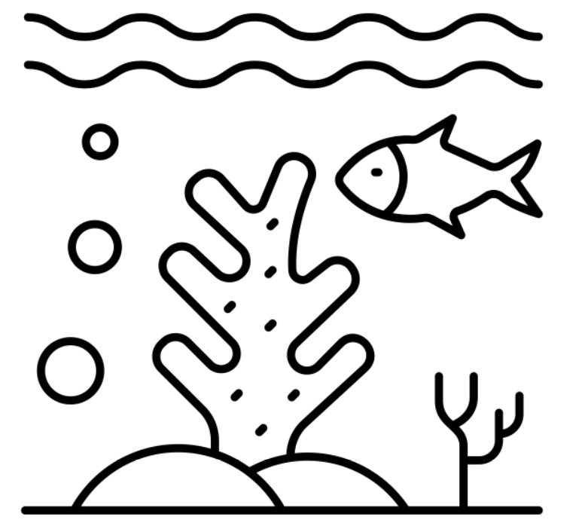
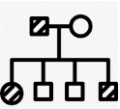
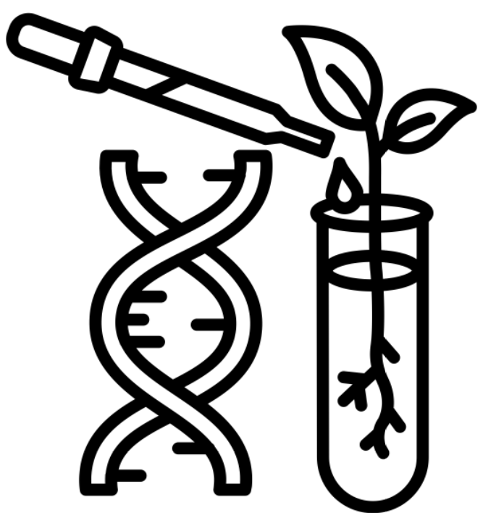
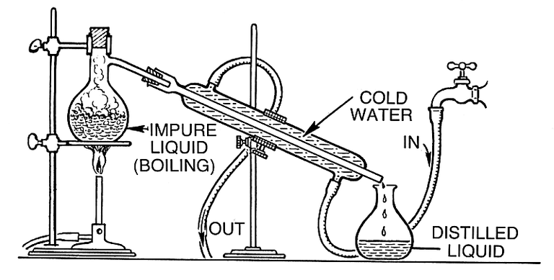
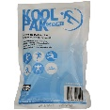
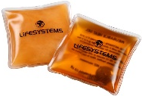
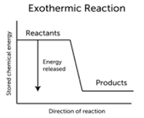
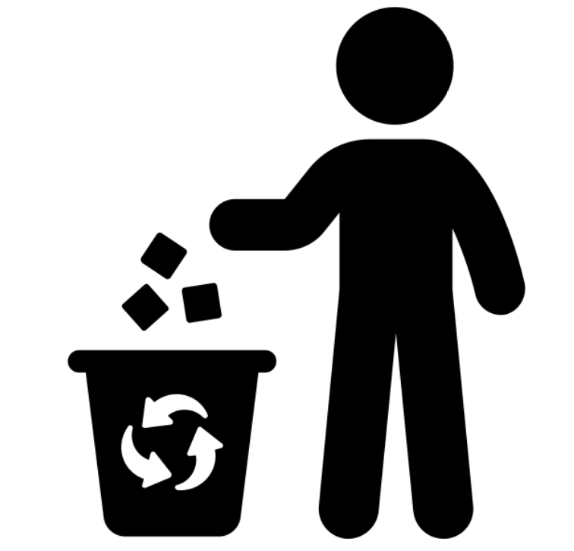
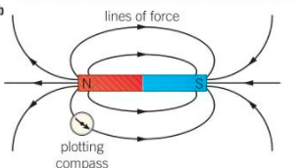
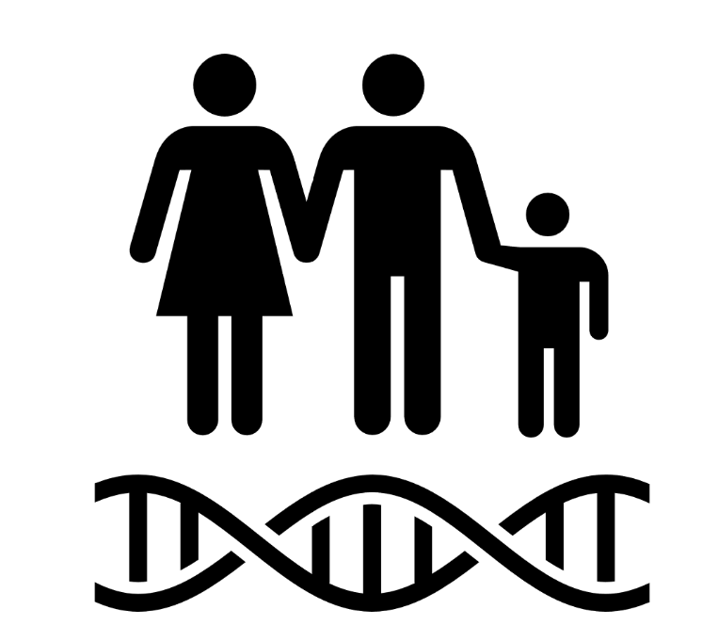
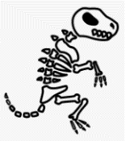
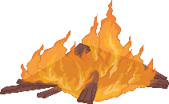
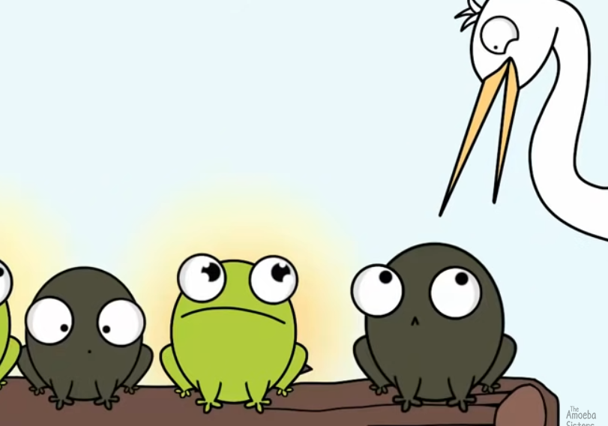
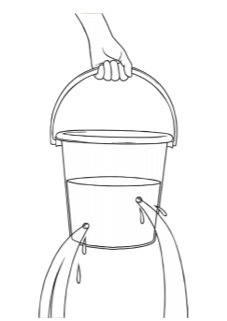
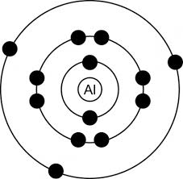
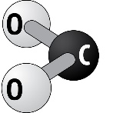
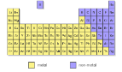
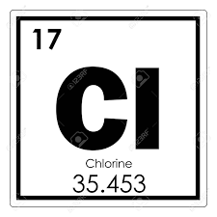
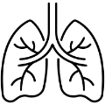
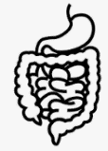
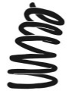
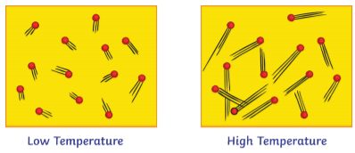
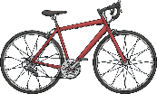
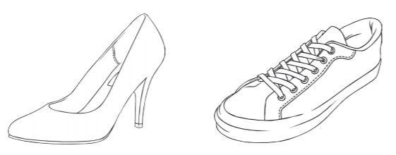
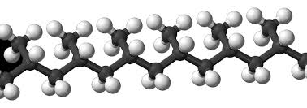
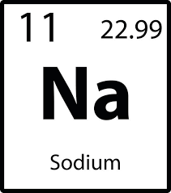
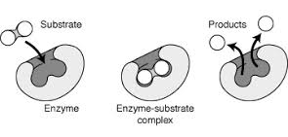
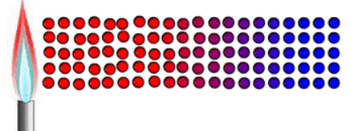
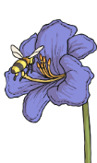
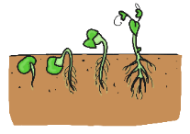
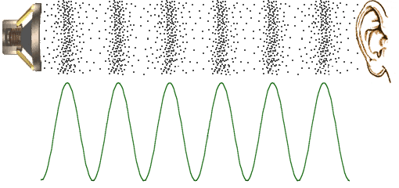
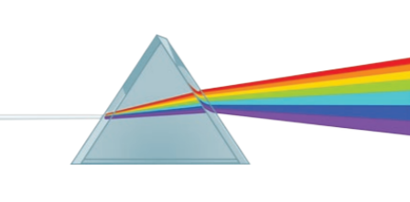
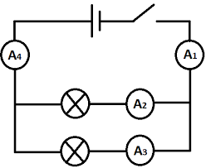
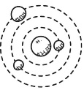
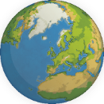
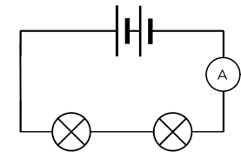
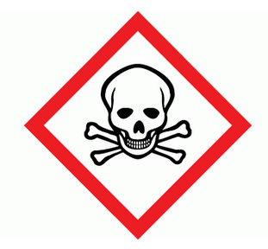
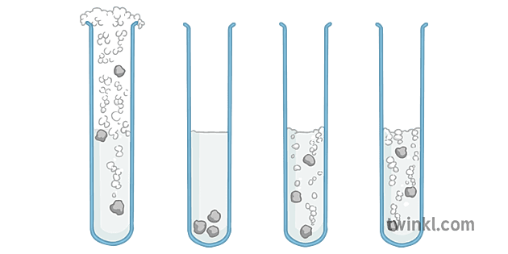
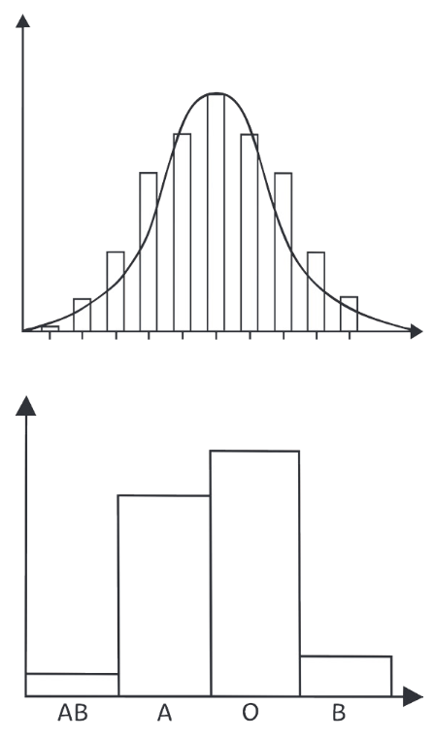
KS3 SCIENCE
Learning journey
St John Henry Newman Catholic School
Understanding variables
Assessing impact of scientific concepts
Drawing conclusions
Evaluation of scientific concepts
Writing
methods
Applying maths to the scientific concepts
Describe patterns
Year 7
Understanding and Applying Scientific Skills
Year 13
Drawing graphs and analysing graphical data
Analysis of secondary data
Modelling scientific concepts
Understanding relationships between science and society
IDEAL
Identify, describe, explain, apply, link
Risk Assessment
Evaluating data and investigations
Sound waves, water waves
energy
Radiation & energy
Anaerobic Respiration
Photosynthesis
Leaves
KS4/5
Biology
The Carbon Cycle
Wave effects
Wave properties
Respiration Photosynthesis
Chemistry
Global warming
Climate
Modelling waves
Aerobic Respiration
Biotechnology
Investigating photosynthesis
Physics
Extracting metals
Applied Science
Earth
resources
Electromagnets
Using electromagnets
Charles Darwin
Biodiversity
Inheritance
Genetic modification
Atoms in chemical reactions
Thermal decomposition
Endothermic exothermic reactions
Climate
change
Magnetism
Evolution Inheritance
Types of reaction
Energy Level
Diagrams
Recycling
Electromagnets
DNA
Genetics
Chemical Energy
Bond energies
Magnet & magnetic fields
Extinction
Natural selection
Conservation of mass
Combustion
Pressure in gases
Pressure in liquids
Elements
Atoms
The Periodic
table
Group 7
Halogens
Food tests
Digestive system
Work, energy & machines
Heating
& cooling
Energy & temperature
Squashing & stretching
Turning forces
Compounds
Breathing
Nutrients
Pressure
Elements
Periodic table
Breathing Digestion
Work
Energy transfer
Radiation
insulation
Friction & drag
Contact forces
Stress on solids
Polymers
Chemical formulae
Group 1
Alkali Metals
Group 0
Nobel Gases
Gas Exchange
Drugs, alcohol & smoking
Unhealthy diet
Bacteria and enzymes in digestion
Energy transfer
particles
H₂0
Current
Current
Potential difference
Seed dispersal
Flowers & Pollination
Fertilisation & Germination
The eye & vision
Light
Loudness & amplitude
The ear & hearing
Sound waves speed
Charging up
Colour
The Moon & Changing ideas
Voltage & Resistance
Reproduction
Light
Sound
The
Night sky
Resistance
Disruptions to food chains & webs
Interdependence
Food chains & webs
Refraction
Series & parallel circuits
Competition
Reflection
Frequency & pitch
Universe
The Solar System
The
Earth
Earth’s structure
Ceramics
composites
Acids
& Alkalis
Indicators & pH
Acid
strength
Neutralisation
Making salts
Metals & acids, oxygen, water
The Menstrual cycle
Adapting to change
Adolescence
Continuous & discontinuous
variation
Food & fuels
Energy dissipation
Structure of the Earth
Chemical Reactions
Acids & Alkalis
Metals &
non-metals
Human
Reproduction
Variation
Energy Transfer
Energy Costs
The Rock Cycle
Metamorphic rocks
Metal displacement reactions
Metals & non-metals
Development of a fetus
Reproductive systems
Fertilisation & implantation
Energy adds up
Energy resources
Energy & power
Sedimentary
rocks
Igneous rocks
Current
Resistance
Potential difference
Current
Skeleton
Charging up
Voltage & Resistance
Movement of substances
Observing cells
Joints
Evaporation & distillation
Filtration
Inside particles
Diffusion
Melting freezing
Boiling
Gravity
Intro to forces
Cells
Muscles
Separating mixtures
Particle model
Speed
KS3
Movement
Gravity
Series & parallel circuits
Uni-cellular organisms
Plant, animal & specialised cells
Levels of organisation
Chromatography
Solutions
solubility
Pure substances & mixtures
Gas pressure
Changes of state
States of matter
The particle model
Distance-time
graphs
Speed
Balanced & unbalanced
CROSS-CURRICULAR LINKS
Isotopes
Chemistry
Energy
Chemistry
Electricity
Engineering
Calculations
Mathematics
Pressure
Chemistry
Radiation dangers
Biology
Atomic models
Chemistry
Detecting light & sound
Biology

