Slide 1
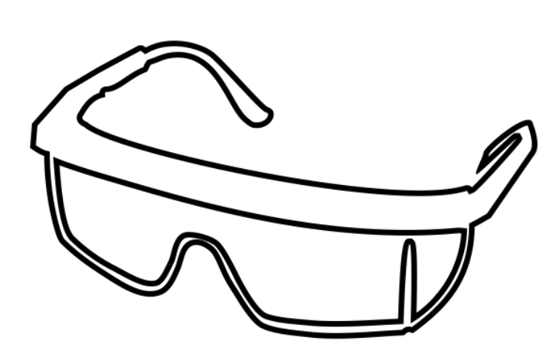
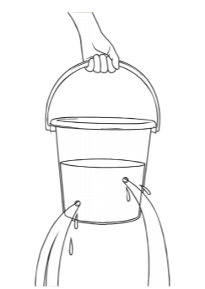
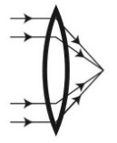
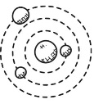
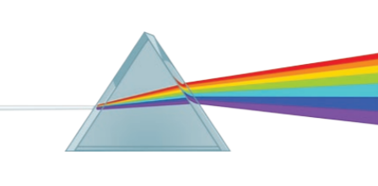
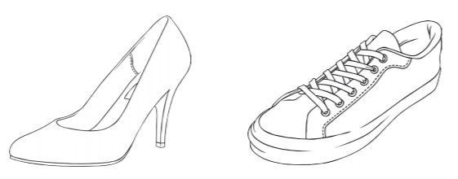
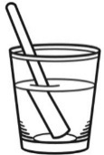
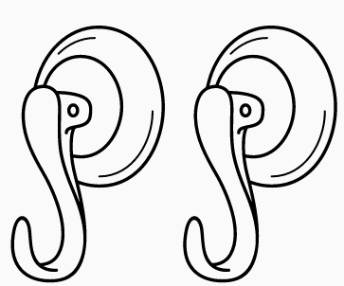
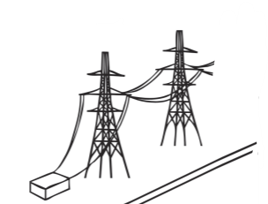
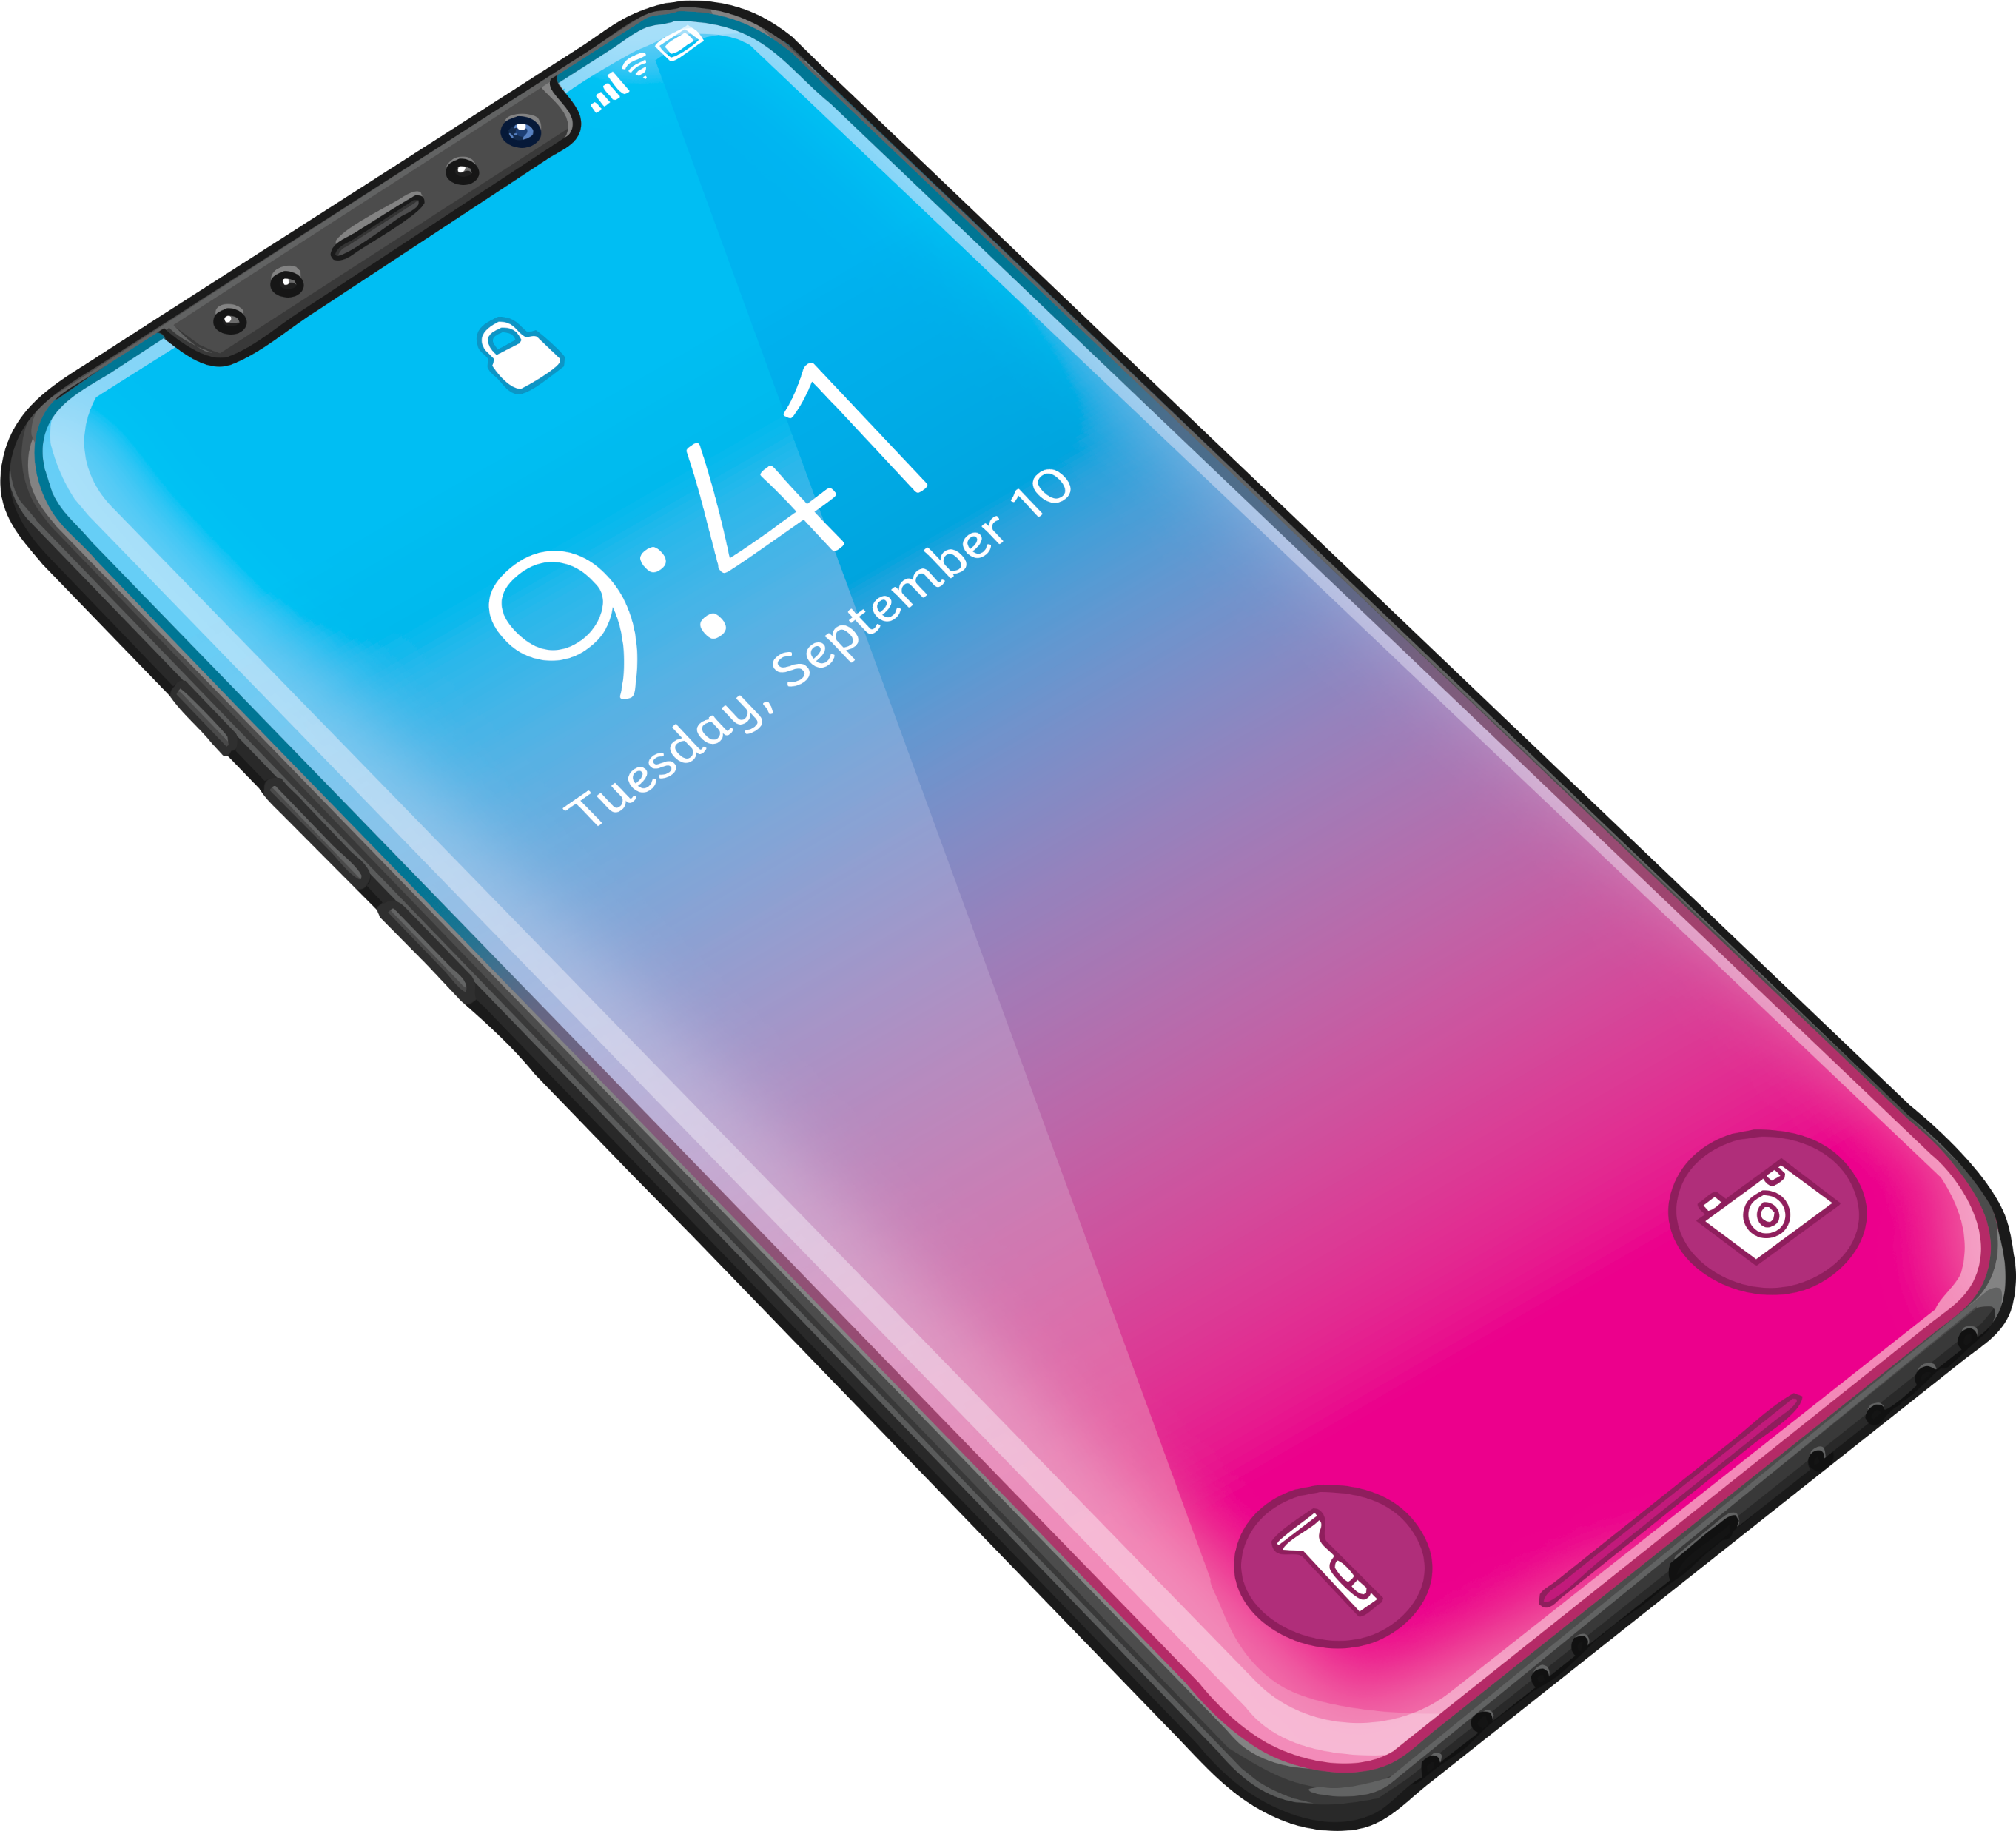
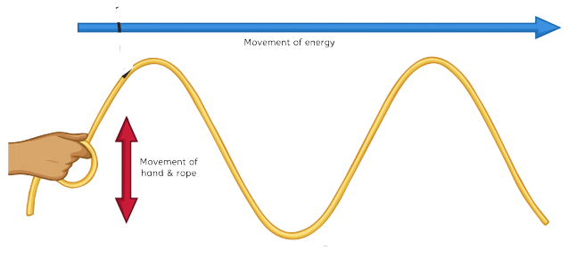
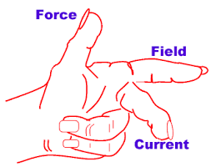
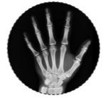
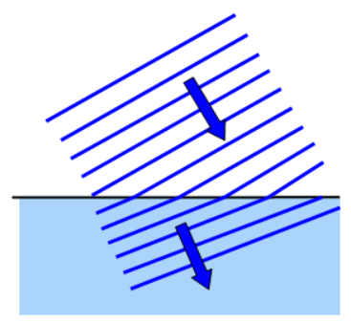
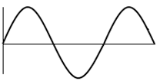
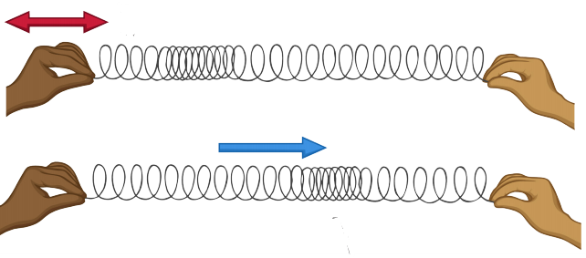
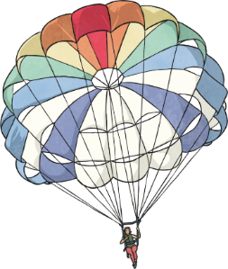
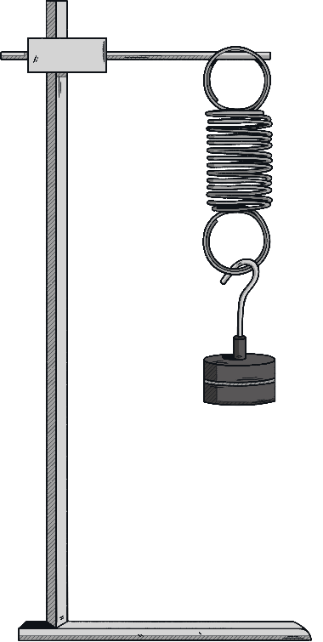
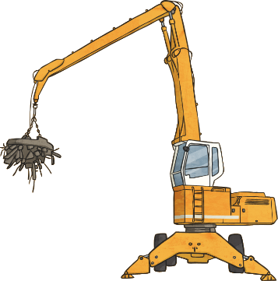
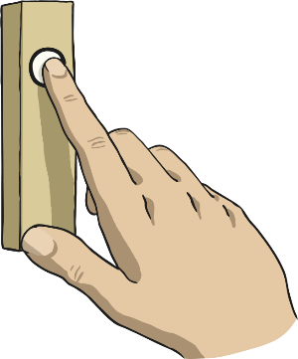
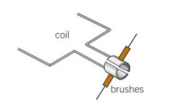
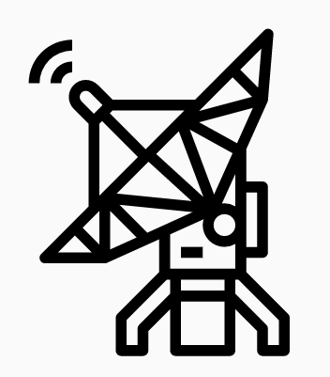
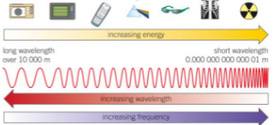
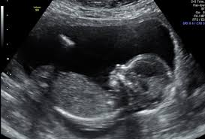
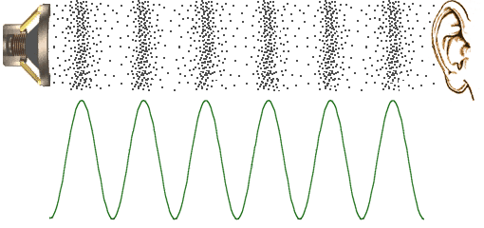
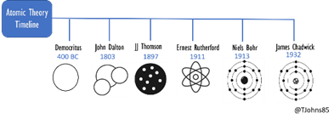
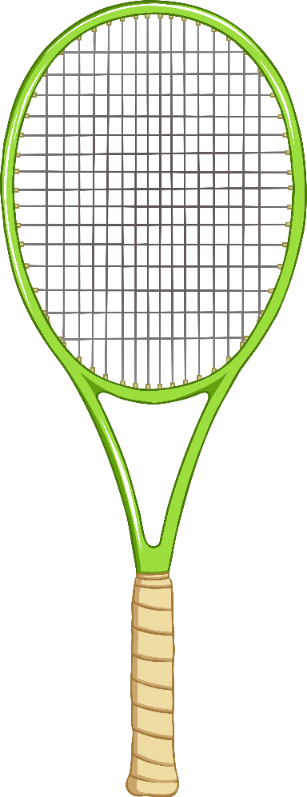
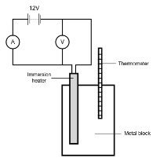
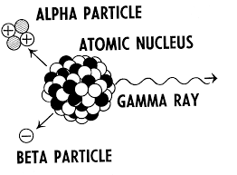
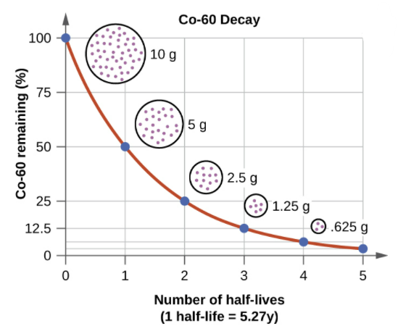
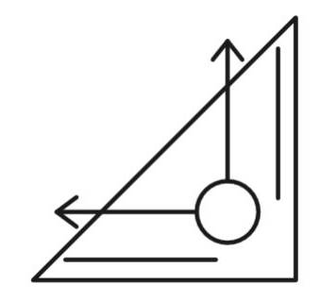
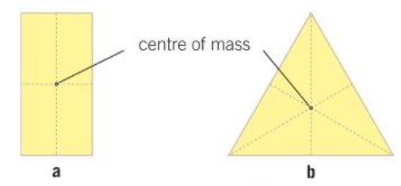
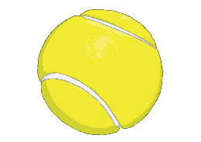
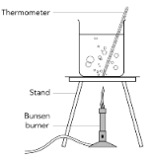
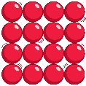
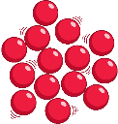
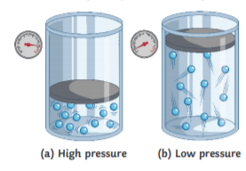
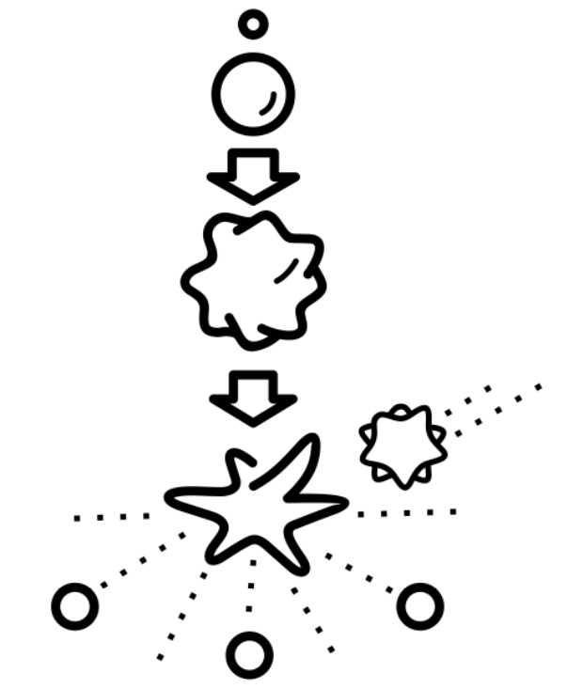
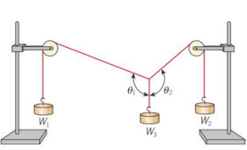
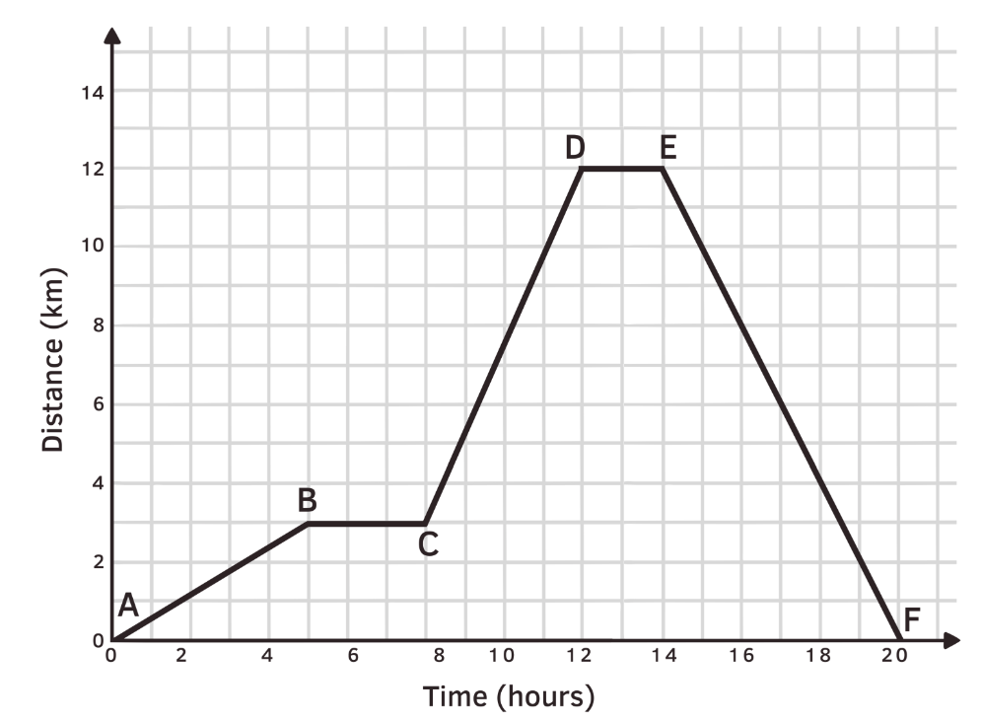
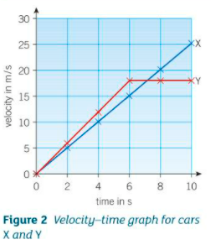
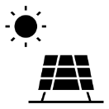
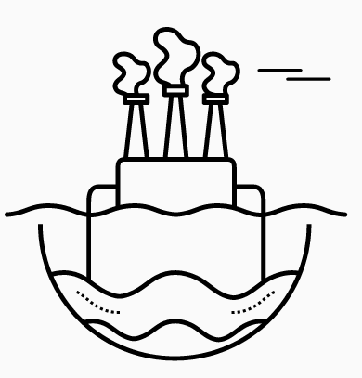
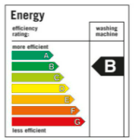
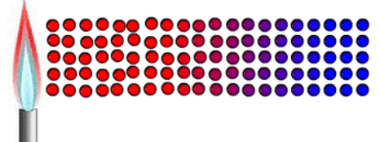
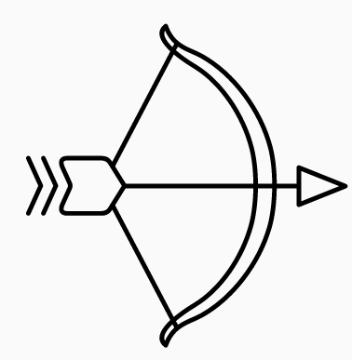
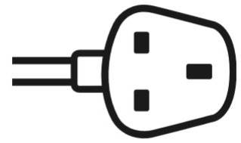
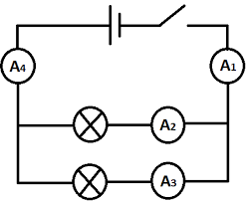
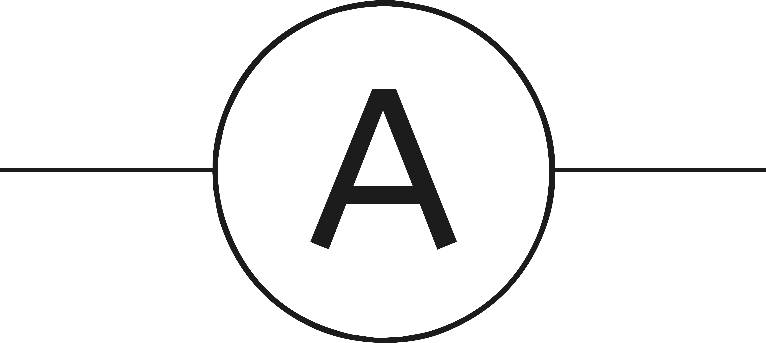
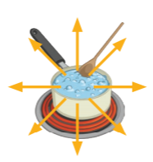
PHYSICS
Learning journey
St John Henry Newman Catholic School
Understanding variables
Assessing impact of scientific concepts
Drawing conclusions
Evaluation of scientific concepts
Writing
methods
Applying maths to the scientific concepts
Describe patterns
Year 7
Understanding and Applying Scientific Skills
Year 13
Drawing graphs and analysing graphical data
Analysis of secondary data
Modelling scientific concepts
Understanding relationships between science and society
IDEAL
Identify, describe, explain, apply, link
Risk Assessment
Evaluating data and investigations
Pressure in a liquid at rest
Light & colour
The life history of a star
Planets, satellites & orbits
GCSE exams
A Level Sciences –
Biology, Chemistry & Physics
(Need grade 6 and grade 6 in Maths)
Upthrust & floatation
Reflection of light
Lenses
Formation of the Solar system
Applied Science A Level
Force and pressure
Light
Space
Pressure on surfaces
Atmospheric pressure
Refraction of light
Using lenses
The expanding
Universe
The beginning &
Future if the universe
Other post 16 options Apprenticeships, college, other A level subjects)
The motor effect
Transformers
Transformers in action
Ultraviolet waves,
X-rays & gamma rays
Light infrared microwaves & radio waves
X rays in medicine
Reflection & refraction
Properties of waves
Nature of waves
Force and acceleration
Forces & elasticity
Electromagnets in devices
Electromagnetism
Electromagneticwaves
Waves properties
Using conservation of momentum
Magnetic fields of electric currents
Magnetic fields
The generator effect
Alternating-current generator
Communications
The electromagnetic spectrum
Seismic
waves
Uses of ultrasound
Sound waves
Momentum
Impact forces
Force and Motion
Forces & breaking
Safety first
Weight & terminal velocity
Specific heat capacity
Discovery & changes in the nucleus
Alpha, beta and gamma
Beta decay and nuclear equations
Half life
Vectors & scalars
Resultant forces
Centre of
mass
Resolution of forces
Analyzing motion graphs
Internal energy
Forces in balance
Velocity acceleration
Radioactivity
Motion
Changes of state
Nuclear radiation in medicine
Nuclear fission, fusion
Nuclear issues
Dangers of ionizing radiation
Moments at work
Levers &
gears
Parallelogram of forces
Speed distance time graphs
Velocity time graphs
States of matter
Molecules and matter
Gas pressure
&volume
Density
Gas pressure & temp
Alternating current
Component characteristics
Electric charges & fields
Energy & the environment
Energy from Sun & Earth
Specific heat capacity
Heat transfer by conduction
Energy & power
Electricity in
the home
Electric circuits
Energy Resources
Energy transfer by heating
Electrical Appliances
Appliances & efficiency
Electrical currents & energy Transfer
Kinetic & elastic energy stores
Year
Cables & plugs
Series & Parallel circuits
Potential difference & resistance
Current & Charge
Big energy issues
Energy from wind & water
Energy demands
Heating & insulating buildings
Infrared radiation
Energy
Energy & work
Gravitational PE
Energy dissipation
Conservation of energy
Efficiency
Pressure in gases
Pressure in liquids
Using electromagnets
Work, energy & machines
Energy & temperature
Sound waves, water waves
energy
KS4
Energy stores
Squashing & stretching
Turning forces
Electromagnets
Wave effects
Wave properties
Friction & drag
Contact forces
Pressure
Magnetism
Work
Heating & cooling
Stress on solids
Electromagnets
Energy transfer
particles
Energy transfer
Radiation
insulation
Modelling waves
Radiation & energy
Magnet & magnetic fields
The eye & vision
Colour
Light
Refraction
Light
Loudness & amplitude
Energy dissipation
Energy & power
Energy adds up
Potential difference
The Moon & Changing ideas
The
Night sky
Sound
Current
Resistance
Gravity
Intro to forces
KS3
Reflection
Energy Transfer
Energy Costs
Current
Voltage & Resistance
Universe
Gravity
Speed
Frequency & pitch
The ear & hearing
Sound waves speed
Food & fuels
Energy resources
Charging up
Series & parallel circuits
The
Earth
The Solar System
Distance-time
graphs
Speed
Balanced & unbalanced
CROSS-CURRICULAR LINKS
Isotopes
Chemistry
Energy
Chemistry
Electricity
Engineering
Calculations
Mathematics
Pressure
Chemistry
Radiation dangers
Biology
Atomic models
Chemistry
Detecting light & sound
Biology

