Slide 1
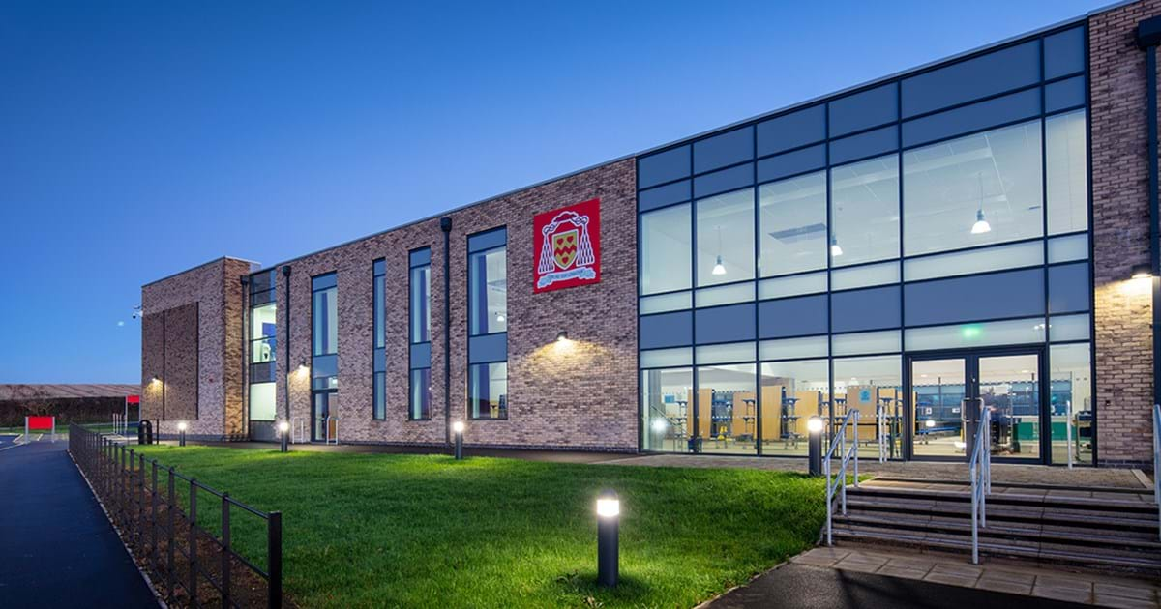
The Way
11th September 2023
Day 1

Slide 2
Lectio Divina – Holy reading
Listen to the reading
Take 1 minute to quietly reflect about the reading
Pick a word or sentence that stand out to you
Keep thinking about this phrase in your head
Why do you think that phrase has stood out to you? What is God trying to tell you?
Share your chosen word/sentence with your form

Slide 3
Sign of the cross
We invite the Holy Spirit, saying together
Come, Holy Spirit, fill the hearts of your faithful
and kindle in them the fire of your love.
Send forth your Spirit, and they shall be created.
And you shall renew the face of the earth.

Slide 4
Luke 6:32-36
³² “If you love those who love you, what credit is that to you? Even sinners love those who love them. ³³ And if you do good to those who are good to you, what credit is that to you? Even sinners do that. ³⁴ And if you lend to those from whom you expect repayment, what credit is that to you? Even sinners lend to sinners, expecting to be repaid in full. ³⁵ But love your enemies, do good to them, and lend to them without expecting to get anything back. Then your reward will be great, and you will be children of the Most High, because he is kind to the ungrateful and wicked. ³⁶ Be merciful, just as your Father is merciful.

Slide 5
Dear Lord,
We ask for guidance and wisdom as we think about what you are teaching us through the reading today.
We ask you give us the strength to love our enemies and pray for those who mistreat us. May we never seek revenge or hold the grudges but instead extend our kindness to all we encounter.
We thank you for showing us how Jesus lived so we can follow his love and obedience and follow in his footsteps.
Amen

Slide 6
Together we say the Lords Prayer.
Our Father, who art in heaven, hallowed be thy name, thy kingdom come, thy will be done on earth as it is in heaven. Give us this day our daily bread and forgive us our trespasses as we forgive those who trespass against us, and lead us not into temptation but deliver us from evil.
Amen.
Sign of the Cross

Slide 7
The Way
11th September 2023
Day 2

Slide 8
Sign of the Cross

Slide 9
Luke 6:32-36
Using the passage we listened to yesterday read through the following reflection.
Then, in silence, think about the answers to the questions.
When ready, share some answers as a class
Remember to be respectful to your peers’ answers. This is a time to understand others and listen.

Slide 10
Reflection
In this passage, Jesus is teaching his disciples about the importance of loving and showing kindness to everyone, including those who may not show kindness to us in return. Jesus is urging his followers to go beyond just showing kindness to those who are kind to them. He is encouraging them to love and show kindness even to their enemies. He emphasizes the importance of being merciful, just as God is merciful.
Kindness should not be conditional. We should not only be kind to those who are kind to us, but we should also be kind to those who are ungrateful, nasty, or even our enemies. This is the ultimate test of kindness - being able to love and show compassion to those who maybe do not deserve it is a hard task. But is doable with the strength from God.

Slide 11
Personal reflection
Who are you currently in conflict with?
Do you show them love and kindness?
Do you find it hard to do this?
Today, how can you be the bigger person by loving and caring for someone even though you may find it hard?

Slide 12
Dear God,
We come before you to ask for you guidance as we reflect on our lives. Help us to show Love, Kindness and Grace to the people we are in conflict with. Allow forgiveness on our hearts that we can be compassionate to others and their needs.
Give us the strength to walk through struggles like Jesus did stepping outside of our comfort zones.
We also pray lord that you help us Love and be kind to ourselves, forgiving our own mistakes and embracing that you have made us unique.
We pray this through Christ our Lord
Amen

Slide 13
The Way
11th September 2023
Day 3

Slide 14
Way to pray
Today we are going start praying using the Rosary
The rosary is form of prayer used in the Catholic Church that involves the repetition of prayers and the reflection of events in the lives of Jesus Christ and the Virgin Mary.
The Rosary consists of a series of prayers and reflections of events in the lives of Jesus and Mary. These events are grouped into four sets of mysteries.
The Rosary typically involves saying five decades of Hail Mary an Our Father and a Glory Be. During each decade, the person praying the Rosary reflects on one of the mysteries while reciting the prayers.

Slide 15
Rosary week 1
First Luminous Mystery: The Baptism in the Jordan
"And when Jesus was baptized, he went up immediately from the water, and behold, the heavens were opened and he saw the Spirit of God descending like a dove, and alighting on him; and lo, a voice from heaven, saying, 'This is my beloved Son, with whom I am well-pleased"' (Mt 3:16-17)

Slide 16
Sign of the Cross

Slide 17
Our Father
Our Father, who art in heaven, hallowed be thy name, thy kingdom come, thy will be done on earth as it is in heaven. Give us this day our daily bread and forgive us our trespasses as we forgive those who trespass against us, and lead us not into temptation but deliver us from evil. Amen.

Slide 18
Hail Mary (we say this 10 times)
Hail, Mary, full of grace, the Lord is with thee: blessed art thou among women, and blessed is the fruit of thy womb, Jesus. Holy Mary, Mother of God, pray for us sinners, now, and at the hour of our death. Amen.

Slide 19
Glory Be
Glory be to the Father, and to the Son, and to the Holy Spirit. As it was in the beginning, is now, and ever shall be, world without end. Amen.
Sign of the Cross

Slide 20
The Way
11th September 2023
Day 4

Slide 21
Saint of the day
Saint Maximillian Kolbe
“The Cross is the school of love.”
Born- 8th January 1894 Died- 14th August 1941

Slide 22
Saint Maximillian Kolbe
Maximilian Kolbe was a Catholic priest and martyr who is known for his selfless sacrifice during World War II. He was born in Poland in 1894 and grew up in a devout Catholic family.
Kolbe was ordained a priest in 1918 and went on to found the City of the Immaculata, a community of Franciscan friars dedicated to spreading the message of the Gospel.
During World War II, Kolbe was arrested by the Nazis and sent to the Auschwitz concentration camp. While there, he continued to minister to his fellow prisoners and was known for his selfless acts of kindness and compassion. In August 1941, a prisoner from Kolbe's block escaped, prompting the Nazis to select ten men from the block to be starved to death as a warning to others. One of the men selected, Franciszek Gajowniczek, cried out for his wife and children, and Kolbe offered to take his place. He was then led away with the other nine men to a starvation bunker.

Slide 23
Despite the horrific conditions in the bunker, Kolbe continued to minister to his fellow prisoners, offering words of comfort and leading them in prayer. After two weeks, he was the only one still alive, and the Nazis decided to end his suffering with a lethal injection of carbolic acid.
Maximilian Kolbe's selfless sacrifice has been recognized as an example of extraordinary courage and love. He was canonized by the Catholic Church in 1982 and is celebrated on August 14 as a saint and martyr. His life continues to inspire people around the world to seek justice, peace, and compassion in the face of adversity.

Slide 24
We are all called to be saints- pope Francis
Have you ever shown a time that you have been selfless like Maximillian Kolbe?
Has there been a time when someone has cried out to you for help? What did you do?
Maximillian Kolbe was brave in Auschwitz. Think of a time you have had to be brave.
What is one thing you can take away from the life of Maximillian Kolbe?

Slide 25
Dear God,
Help us to learn from St Maximillian Kolbe. He was brave, selfless and inspirational. Help us to grow as Kolbe did with the help of the Blessed Virgin Mary.
Show us how our actions can help others around us with simple acts of kindness and bravery.
Allow us to be reminded of the willingness that Kolbe had to lay down his life for the sake of others, putting others needs before himself.
We pray this in your name Lord
Amen
Saint Maximillian Kolbe, Pray for Us.

