Slide 1

Y11 Revision: Advice from your subject areas…
"The harvest is plentiful, but the laborers are few.“
(Matthew 9:37)

Slide 2
Welcome to Your Y11 Revision Guide!
This guide has been created by your teachers to help you make the most of your revision. Inside, you’ll find expert guidance, carefully chosen resources, and proven strategies to strengthen your knowledge and build confidence ahead of your exams.
Remember to visit the Revision Hub on the school website to access a digital version with live hyperlinks.

Slide 3
How to Revise Effectively
To revise successfully, use strategies that actively engage your brain:
Create a Revision Timetable – Plan study sessions to cover all subjects and prevent last-minute cramming. How do I make a revision timetable for my exams? - BBC Bitesize
Active Recall – Test yourself regularly using flashcards, quizzes, or past paper questions.
Spaced Repetition – Spread revision over time rather than cramming to retain information better.
Past Papers & Mark Schemes – Practice exam questions under timed conditions to refine your answers.
Mind Maps & Summaries – Condense key information into diagrams and bullet points.
Teach Someone Else – Explaining a topic reinforces understanding and highlights gaps.

Slide 4

Using GCSEPod to Enhance Your Revision
GCSEPod is a fantastic tool to support your studies with thousands of
expert-created ‘Pods’ (short videos). Here’s how you can use it effectively:
Watch Pods to Review Topics – Reinforce learning with clear explanations.
Create Personal Playlists – Organise Pods by subject or topic for targeted revision.
Check and Challenge – Test yourself with multiple-choice questions to assess understanding.
Track Your Progress – Identify areas for improvement and focus your revision where needed most.
Flashcards – Use the content to create flashcards and test yourself regularly!
By combining all the strategies mentioned in this revision guide with high-quality resources like GCSEPod, you’ll be well on your way to exam success!

Slide 5
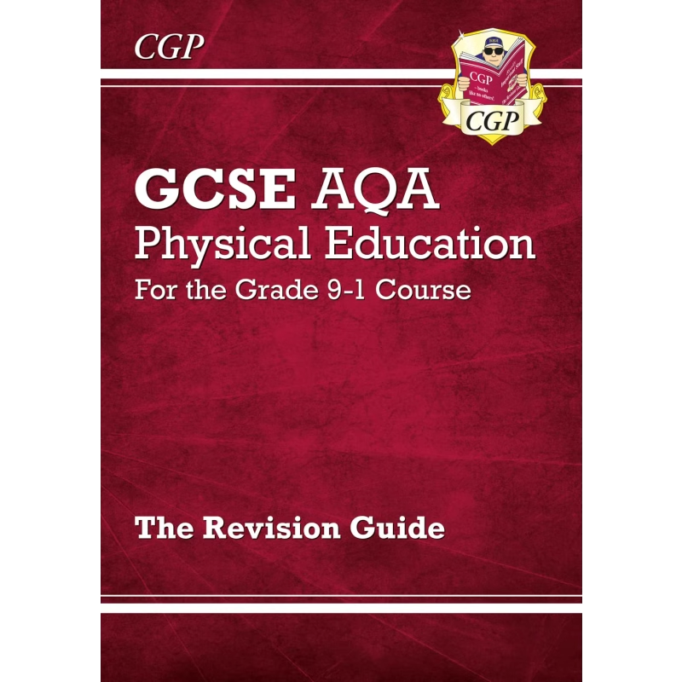
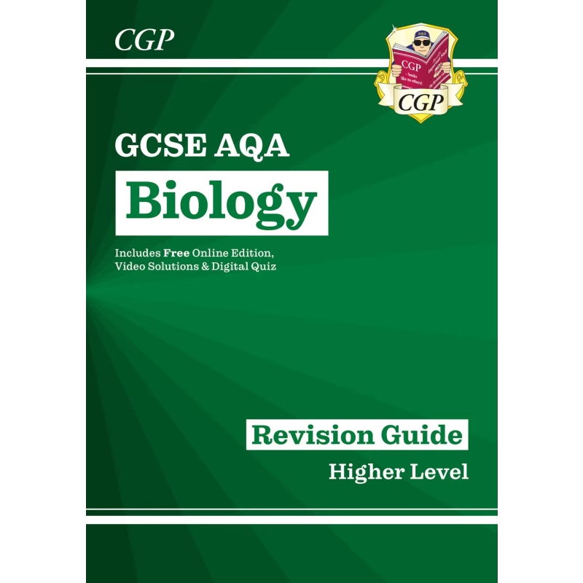
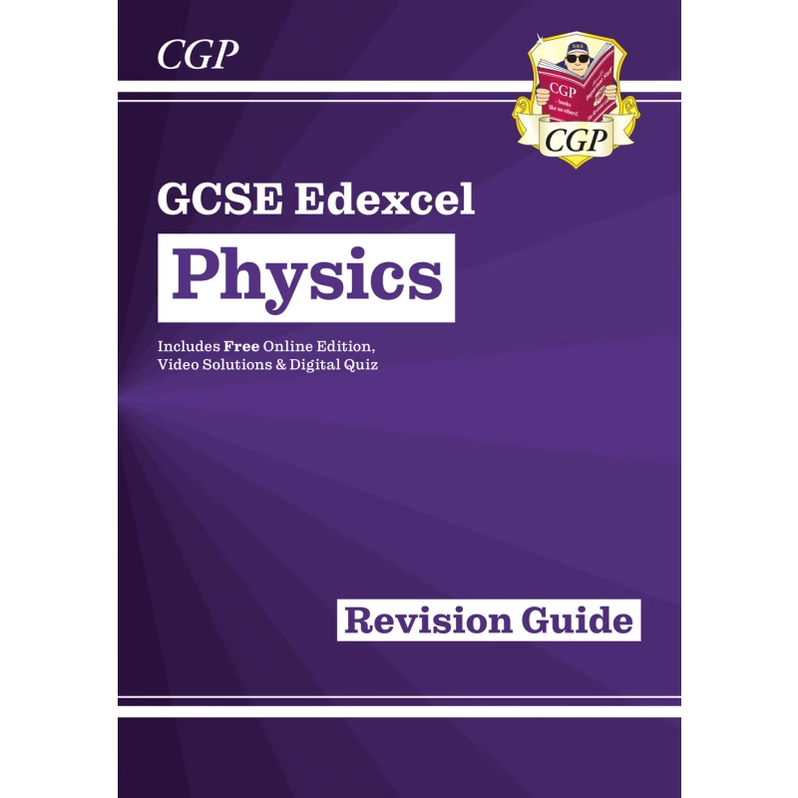
Using Your CGP Revision Guides Effectively
CGP revision guides are excellent tools for effective revision. They break down complex topics into clear, concise explanations with easy-to-understand language.
Here are some ways you can use CGP revision guides effectively for revision:
Summarising Key Points – Read a section and create summary notes or mind maps to condense the information.
Active Recall – Cover the page and try to recall key facts, then check your answers.
Practice Questions – Use the end-of-topic questions to test understanding and improve exam technique.
Flashcards – Turn key facts and definitions into flashcards for quick revision.
Exam-style Questions – Work through past paper-style questions to get familiar with exam formats.
Teach Someone Else – Explain concepts to a friend or family member to reinforce learning.
Highlighting & Annotating – Use highlighters to mark key points and add your own notes.
Timed Revision Sessions – Set a timer to go through specific topics, ensuring efficient study.
By combining these methods, you can make the most of your CGP guides and boost your revision.

Slide 6
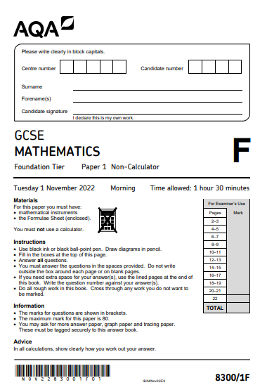
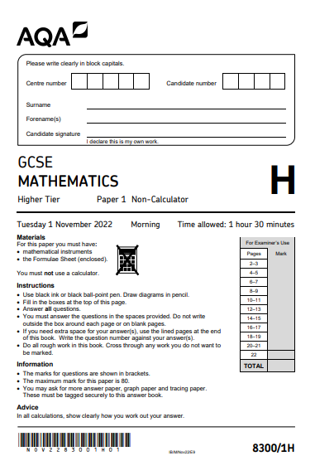
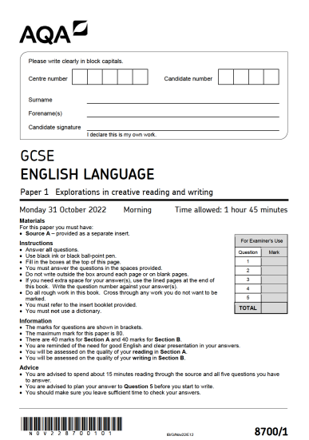
Using Past Papers Effectively
Using past papers effectively while revising can significantly improve your exam preparation.
Here’s a step-by-step guide:
Collect the Right Materials – Gather past papers, mark schemes, and examiner reports.
Practice Under Exam Conditions – Time yourself to simulate real exam scenarios.
Mark and Review – Use the mark scheme to check answers and learn from mistakes.
Identify Weak Areas – Focus on topics where you lost marks and revise accordingly.
Repeat and Track Progress – Complete multiple papers to improve consistency.
Discuss and Reflect – Go over tricky questions with peers or teachers to reinforce learning.
Stick to these tips, and you'll boost your exam confidence and performance!

Slide 7
RE
RE is Edexcel Specification A Religious Studies papers 1A, 2F and 3A
Seneca is great for revision
Seneca is also available as podcasts at https://open.spotify.com/show/16dO2bh2jKJuaqc7EE3xVw?scrlybrkr=33913eea
GCSE Pods for Jewish beliefs and teachings, Jewish practices, Catholic beliefs and teachings and catholic practices.
Some Tik Toks for you to watch:
https://www.tiktok.com/@gcsereligion Revision tips.
https://www.tiktok.com/@mrs.dawson.re Catholic revision.
https://www.tiktok.com/@nataliezadrima A practicing Catholic who posts videos of her doing things like the rosary and explaining different aspects of the faith.
https://www.revisely.com/gcse/religious-studies/edexcel This has great revision materials including revision videos
mingerism – YouTube Great for revision videos
St. Bede's Blackburn RE – YouTube Great for revision videos
GCSE Religious Studies - Edexcel - BBC Bitesize Lots of revision materials for Edexcel RE

Slide 8
Maths
Use SparxMaths (and other resources) to work on areas of weakness identified by your most recent QLA sheet.
Work through past papers from sites such www.mathsgenie.co.uk.
  We are an AQA school, but any exam board will do!
  Complete it within timed conditions.
  Mark it yourself (be harsh!).
  Study the topics that you didn’t do so well on.
Use www.1stclassmaths.com for topic-based revision by grade and best guess papers.
Use www.mathsgenie.co.uk for topic-based revision by grade.
Use www.onmaths.com for self marking best guess papers.
Use www.hannahkettlemaths.co.uk for weekly past papers (including live Thursday night sessions on TikTok and Youtube).
Be on the lookout for AQA best guess/predicted papers during the exam season. As each real paper is completed, many online authors create papers that hone in on what is left to be tested!
Don’t forget – the only way you can get better at Maths is by doing Maths!

Slide 9
English Language
There are a number of ways in which you can revise for English Language.
Firstly, you can use the AQA website to download a selection of past papers and I am sure that your English teacher will look at them for you. You will also find the mark schemes on this website. AQA | English | GCSE | GCSE English Language
There are a number of websites which can be useful: GCSE Bitesize, Save My Exams, Get Revising and Revision World to name a few.
Follow Mr Bruff on YouTube – a channel with in-depth analysis, exam tips and model responses.
Read a range of fiction and non-fiction texts at home.

Slide 10
English Literature
Over the course of the last two years, you have studied: Romeo and Juliet, An Inspector Calls, A Christmas Carol, Relationships Poetry and Unseen Poetry. You will be assessed on these during 2 examinations.
Tips for revision:
Use the Revision Guides which you have been given.
You can download and complete past papers from the Edexcel website. Edexcel GCSE English Literature (9-1) from 2015 | Pearson qualifications
Make flash cards, mind-maps etc about the key characters, themes and context (no context in A Christmas Carol). GCSEPod is great for this!
Follow Mr Bruff on YouTube – a channel with in-depth analysis of key texts, including poetry, plays, and novels, including essay writing tips.

Slide 11
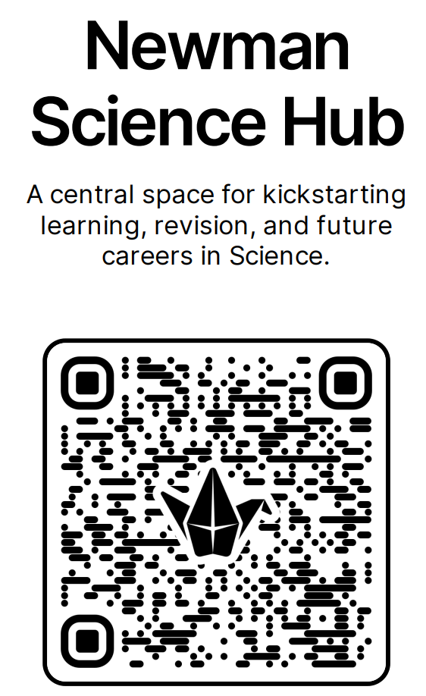
Science 2026: You’ll fine many resources linked on the Newman Science Hub – Try some of these resources for success.
You will find Cognito's science revision videos perfect for making flash cards and don't forget to explore their website for more resources, including video lessons, revision notes, and past papers: Cognito Edu
Curriculum - Curriculum Continuity OAK is a good place to find teacher led lessons for all your science topics, the summary lessons are perfect for revision and will help keep you focused.
Primrose Kitten has the best videos for summarising each paper in less than an hour video – ideal for last minute revision and PPE preparation. Primrose Kitten | GCSE and A-Level Revision | Primrose Kitten
Physics & Maths Tutor: Best place to find comprehensive revision notes, exam questions by topic, mind maps and videos for each module of the AQA GCSE sciences syllabus, not just Physics! Physics & Maths Tutor
Study Rocket — free Exam-Specific A-level & GCSE Revision Content Free revision notes, lessons, and assessment questions for AQA GCSE Science and more.
At Focus you will find animations for all the required practical's – collect data and draw graphs, all at the touch of a button. https://www.focuselearning.co.uk/u/32876/nxezbedbfedCBAyDpBrseAsACApxtbzby
Save my Exams is perfect for all your revision needs – lots of free resources but there is a limit. GCSE Revision Notes & Exam-Style Questions
TIP - For creating revision flashcards and mind maps for AQA GCSE Science, the best sites are Quizlet for flashcards (Quizlet), Coggle for mind maps (Coggle), GoConqr for both flashcards and mind maps (GoConqr), Revisely for AI-powered flashcard generation (Revisely), and Collins GCSE Revision for downloadable flashcards (Collins GCSE Revision).

Slide 12
Geography
Past Papers – Go through a timed paper without any support. Then, go through with a different colour pen (and revision guide) to see what you missed and add improvements.
Revise Case Studies –shrink key facts, dates and locations onto a mind map or flashcard for each key location you study (only focus on a few key details!)
Learn the key vocabulary for each topic and exam questions e.g. distribution, disparity, development gap. This makes reading and understanding exam questions easier and quicker!
Know your fieldwork title, data collection and data presentation methods for Paper 3!
Some helpful websites:
  https://www.physicsandmathstutor.com/geography-revision/gcse-aqa/ → Ready made revision notes, flash cards etc
  GCSE Geography Interactive Revision - Internet Geography → Ready made knowledge organisers, mind maps, flash cards etc
  GCSE Pod → Quick simple videos and mini quizzes.

Slide 13
History
Flash cards work well for the Medicine unit, especially for revising the individuals and how they contributed to developments in medicine.
The BBC Teach History Medicine Through Time video clips on Youtube are also a useful resource for the Medicine unit.
Mind maps work well for topics like Germany and WW1. For example, you could mind map the causes of WW1 and explain different factors.
Timelines work well for all of the GCSE topics.
For the Normans unit, make sure you know the site study thoroughly (Pevensey Castle). This is the only question that is guaranteed to come up on the exam.
When you are confident with the subject content, work on practice questions. Make sure you use a timer and green pen your work afterwards using your revision guides.
Useful websites:
https://www.bbc.co.uk/bitesize/examspecs/zxjk4j6
https://quizlet.com/gb/content/gcse-history-revision

Slide 14
Construction
Download or print off the two revision booklets that are in the BTEC Construction folder.
Make flash cards on the materials used in the construction industry.
BTEC Firsts Construction & Built Environment (2018) | Pearson qualifications

Slide 15
Music
Flashcards work well for the key terminology and set works.
Revise the elements of music in the set works (Africa and Badinerie)
Revise the elements in the music theory section in this link, as well as the sections on Africa and Badinerie
Use this link to revise key terms: https://resources.eduqas.co.uk/Pages/ResourceSingle.aspx?rIid=1289
Use this link to complete practice questions: https://resource.download.wjec.co.uk/vtc/2015-16/15-16_22/website/eng/index.html

Slide 16
GCSE PE
Complete all HW tasks as directed by staff which will help you to recall/retrieve previous learning through Everlearner tasks and sharpen exam technique to answer written past paper questions.
Independently -
Identify topic areas that were weaker from the November mock and prioritise revision for those topics.
Use the 2025 infographic sheets with past paper analysis to ensure you know the 'hot topics' that are likely to feature in this year's papers.
Use The Everlearner website to watch short videos and test yourself with questions (Home :: The EverLearner).
Use other learning platforms such as – (GCSEPod), (GCSE Physical Education - Edexcel - BBC Bitesize)
Use your GCSE PE Revision guide - BE ACTIVE with your revision!!

Slide 17
Hospitality and Catering
Past papers WJEC board
  Complete it within timed conditions.
  Mark it yourself (be harsh!).
  Study the topics that you didn’t do so well on.
  Level 1/2 vocational Award in Hospitality and Catering
Download the Specification – make flash cards on the key topics.
Work through the revision book you have been given.

Slide 18
DT
Make use of your 'Clear Revise' revision book. The end of each section contains revision questions based on that topic.
Use the BBC Bitesize link to support revision - https://www.bbc.co.uk/bitesize/examspecs/zby2bdm
Past papers
  Complete it within timed conditions.
  Mark it yourself (be harsh!).
  Study the topics that you didn’t do so well on.
  AQA | Design and Technology | GCSE | GCSE Design and Technology
Use GCSE pod

Slide 19

Spanish
Know your verbs and tenses. Flashcards are a good way of learning these. This website can help revise: https://conjuguemos.com/activities/spanish/verb/1
Boost your range of vocabulary. This is a great book to use (CGP GCSE Spanish – The Vocab Book).
Know your question words.
Use Seneca and GCSE Pod to revise topics you feel less confident with.

Slide 20
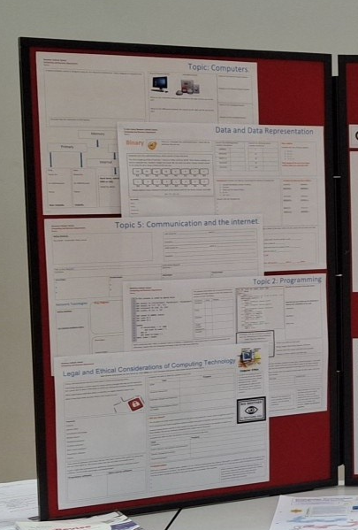
Computer Science
Make use of your 'Clear Revise' revision book. The end of each section contains revision questions based on that topic.
Use your 'recommended areas for revision' to select topics to revise. These were provided following the PPEs.
You have been given five knowledge organisers – complete these in black pen with what you know, use a green pen to fill those knowledge gaps. Use these to produce flash cards or post it notes. The better the job you do on these, the better quality revision resource you will have.
With each revision topic you will be given a supporting booklet with revision notes – highlight key words, use this to write questions.
You could rank each topic from best to worst – revise them in reverse order.
The following link provides interactive revision on a range of topics:
  https://www.advanced-ict.info/interactive/revision.html
  This is the link currently added to Arbor

Slide 21
iMedia
Make use of your 'Clear Revise' revision book. The end of each section contains revision questions based on that topic. Review your answers and identify which areas you need to focus your revision on.
Arbor contains an assignment with the individual knowledge organisers for topic areas 1, 2 and 3 to support for your revision for R093.
Use this link to access a range of videos to support topics across R093: https://www.youtube.com/playlist?list=PL3KFKOfmI1eChW_uH89bZRIeQyOWh7ONn
Use these videos to produce flash cards, post it notes, key words lists, mind maps.
The following revision site has FREE access until the end of March. NO PAYMENT DETAILS ARE REQUIRED.
https://erevision.uk/?scrlybrkr=fd1756fa

Slide 22
Health and Social Care
Past papers for Component 3 : Health & Social Care (2022) | BTEC Tech Award | Pearson qualifications
Tutor2U Component 3 Revision - https://www.youtube.com/playlist?list=PLp8BSCLLWBUA-4mj_vxoHdCkAQYth_PbR
BBC Bitesize Revision - https://www.youtube.com/playlist?list=PLJl5rFr3KefC3J8eHvMJ87Ryu10uLKR5R

