Slide 1

Sixth Form Revision: Advice from your subject areas…
"The harvest is plentiful, but the laborers are few.“
(Matthew 9:37)

Slide 2
Welcome to Your Sixth Form Revision Guide!
This guide has been created by your teachers to help you make the most of your revision. Inside, you’ll find expert guidance, carefully chosen resources, and proven strategies to strengthen your knowledge and build confidence ahead of your exams.
Remember to visit the Revision Hub on the school website to access a digital version with live hyperlinks.

Slide 3
How to Revise Effectively
To revise successfully, use strategies that actively engage your brain:
Create a Revision Timetable – Plan study sessions to cover all subjects and prevent last-minute cramming. How do I make a revision timetable for my exams? - BBC Bitesize
Active Recall – Test yourself regularly using flashcards, quizzes, or past paper questions.
Spaced Repetition – Spread revision over time rather than cramming to retain information better.
Past Papers & Mark Schemes – Practice exam questions under timed conditions to refine your answers.
Mind Maps & Summaries – Condense key information into diagrams and bullet points.
Teach Someone Else – Explaining a topic reinforces understanding and highlights gaps.

Slide 4
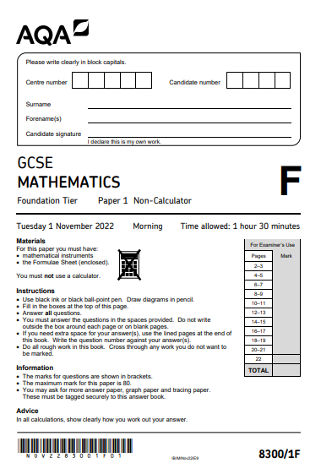
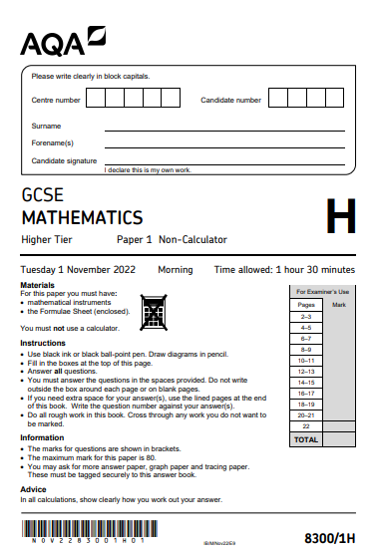
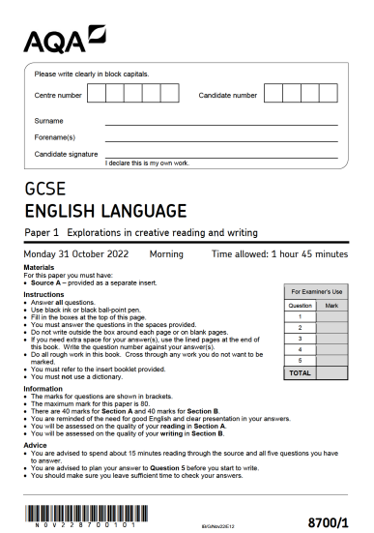
Using Past Papers Effectively
Using past papers effectively while revising can significantly improve your exam preparation.
Here’s a step-by-step guide:
Collect the Right Materials – Gather past papers, mark schemes, and examiner reports.
Practice Under Exam Conditions – Time yourself to simulate real exam scenarios.
Mark and Review – Use the mark scheme to check answers and learn from mistakes.
Identify Weak Areas – Focus on topics where you lost marks and revise accordingly.
Repeat and Track Progress – Complete multiple papers to improve consistency.
Discuss and Reflect – Go over tricky questions with peers or teachers to reinforce learning.
Stick to these tips, and you'll boost your exam confidence and performance!

Slide 5
Maths
Work through past papers from sites such www.mathsgenie.co.uk.
  We are an Edexcel school, but any exam board will do!
  Complete it within timed conditions.
  Mark it yourself (be harsh!).
  Study the topics that you didn’t do so well on.
Use www.TLMaths.com for topic-based videos covering the entire syllabus/textbook.
Use www.physicsandmathstutor.com for past papers questions by topic.
Use www.ALevelMathsRevision.com for more past exam questions by topic.
Follow @MrAstburyMaths on Youtube for best guess papers.

Slide 6
English Language
You are completing the OCR course.
Firstly, you can download a selection of past papers and complete them at home. You teacher will endeavour to mark them and give you feed back. AS and A Level - English Language - H070, H470 - OCR
Make flash cards or mind-maps about key themes, key characters and the context of the texts you have studied.
Use the revision site getrevising.co.uk.
Read the candidate exemplars which have been shared with you by your teacher.
Use the revision guides which have been supplied.

Slide 7

Y13 AQA Applied Science
Only Unit 4 to prepare for this summer 2026!
You’ll fine many resources linked on the Newman Science Hub – Try some of these resources for success.
Applied Science unit 4 - The Human body Flashcards | Quizlet
AQA | Science | Applied General | Applied General Science for past papers.
Free Level 3 Applied Science AQA Revision Content — Study Rocket Scroll down to find links to the Human body topic with revision notes and videos.

Slide 8
Y12 OCR Applied Science
Two exams to prepare for this summer 2026!
F180 Fundamentals of Science
F181 Science in society
You’ll fine many resources linked on the Newman Science Hub – Try some of these resources for success.
Free Level 3 Applied Science AQA Revision Content — Study Rocket Scroll down to find revision notes and videos for key Concepts in Science
Physics & Maths Tutor Lots of A level resources which match our course – make sure you use the specification to find relevant content here.
ZIGZAG Text book– the best place to access relevant course information with practice questions and checklists.

Slide 9
Physics – No exams summer 2026
You’ll find many resources linked on the Newman Science Hub – Try some of these resources for success.
Revisely: Offers AQA A Level Physics questions by topic, notes, videos, and past papers. It's a comprehensive resource for structured revision. Revisely AQA A Level Physics
Save My Exams: Provides clear and structured revision notes, illustrations, and examiner tips specifically for AQA A Level Physics. Save My Exams AQA A Level Physics
Physics & Maths Tutor: Includes summary notes, worksheets, and past exam questions for each section and paper of AQA A Level Physics. Physics & Maths Tutor AQA A Level Physics
StudyWise: Offers a variety of resources including notes, summary sheets, and explanations tailored for AQA A Level Physics. A-Level Physics Revision - StudyWise
PhysicsNet: Provides detailed notes and explanations for AQA A Level Physics topics, making complex concepts easier to understand. A-level physics AS A2 AQA GCE new 2015

Slide 10
Product Design
Make use of your 'Clear Revise' revision book. The end of each section contains revision questions based on that topic.
Use the BBC Bitesize link to support revision - https://www.bbc.co.uk/bitesize/examspecs/zby2bdm
Past papers
  Complete it within timed conditions.
  Mark it yourself (be harsh!).
  Study the topics that you didn’t do so well on.

Slide 11
Psychology
Tutor2U revision blast videos on all subjects: https://www.tutor2u.net/live/archive?subject=psychology&level=a-level
Psychboost videos for all subjects (our favourite purple man): https://www.youtube.com/@PsychBoost -
A Level Psychology revision: https://www.youtube.com/watch?v=JOFmzxkwOwI&list=PLPyIFM6OV7iscUdUE_0AXLcXvyb2zvmIb
Bear it in mind psychology revision: https://www.youtube.com/@BearitinMIND
How to get an A* in Psychology: https://www.youtube.com/watch?v=5-juhLOQgGY&list=PL7O6CcKg0HaFgOm7c31j70IYX92WRgcWS
SM Cartledge Psychology revision: https://www.youtube.com/@smcartledge2723/playlists

Slide 12
Health and Social Care
Exam revision for Units 1 and 2
Alan's Lessons Revision video and exam walk-throughs: https://www.youtube.com/playlist?list=PLusj-IUbWkJ6Veu2LqmGeu625s62DmBbi
Tutor2U Unit 1: https://www.youtube.com/playlist?list=PLp8BSCLLWBUDQU8pYJ810RELKm2T7dfYX
Turor2U Unit 2: https://www.youtube.com/playlist?list=PLp8BSCLLWBUAjIZr1No5-_p8Ji8gTDKN3

