Slide 1
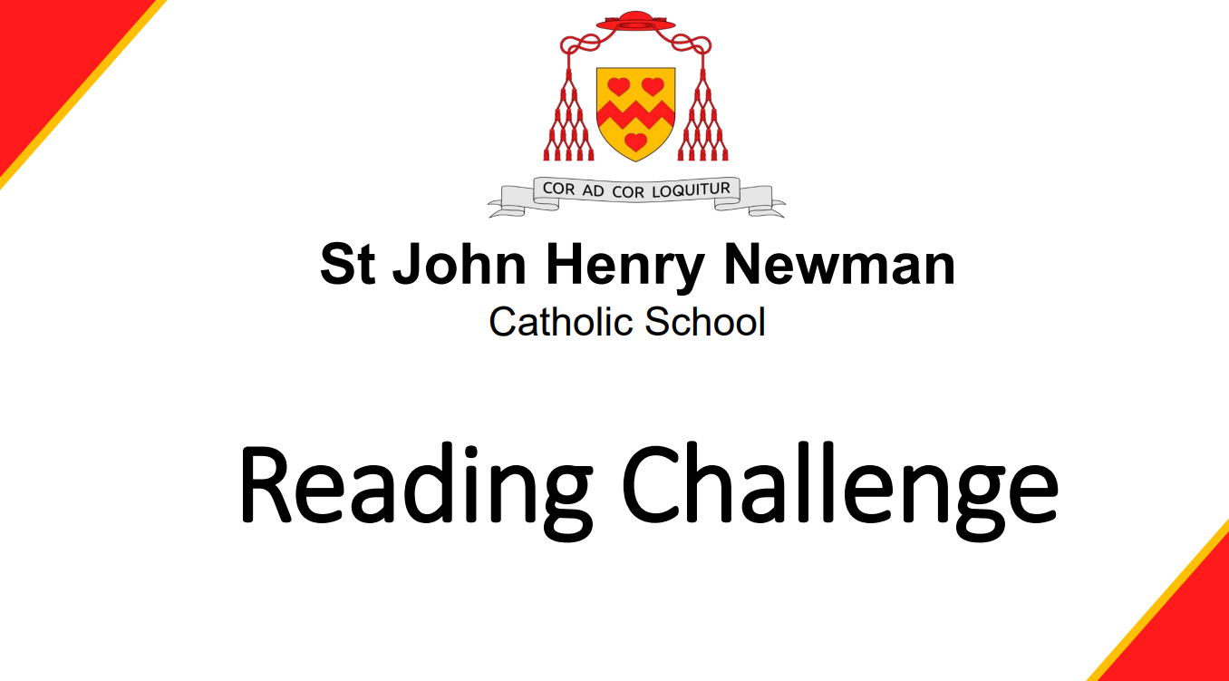

Slide 2
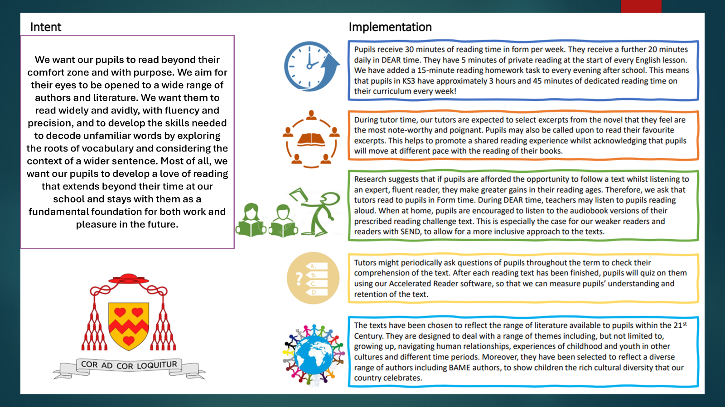

Slide 3
Year 7
Text | Author | Pages | Curriculum Links
You Are Awesome | Matthew Syed | 152 | Ourselves, PSHE
The humiliations of Welton Blake Alex Wheatle | Alex Wheatle | 138 | Families, Humorous stories, Relationships
The boy with big decisions | Helen Rutter | 337 | Humorous stories, Bullying, Disabilities, Neurodiversity
The Final Year | Matt Goodfellow | 288 | Families, School stories, Bullying, Mental Health, Self-esteem / self-acceptance, Novels in verse

Slide 4
Year 8
Text | Author | Pages | Curriculum Links
My name is Samim | Fidan Meikle | 293 | Adventure stories, Black, Asian or minority ethnic characters, Immigration, Refugees
People like stars | Patrice Lawrence | 294 | Families, Mystery stories, Black, Asian or minority ethnic characters
Gloam | Jack Mackay | 256 | Emotions, Families, Horror stories, Monsters, Mythical creatures, Self-esteem / self-acceptance Supernatural
Shrapnel Boys | Jenny Pearson | 367 | Crime, Families, Friendship, Historical stories, London, Self-esteem / self-acceptance, World War 2

Slide 5
Year 9
Text | Author | Pages | Curriculum Links
My name is Jodie Jones | Emma Shevah | 336 | Emotions, Families, Friendship, Mental Health, School stories
Wildlands | Brogen Murphy | 402 | Adventure stories, Ecology, Nature, Parents, Science fiction, Siblings
A flash of neon | Sophie Cameron | 229 | Friendship, Imagination, Literary fiction, Mythical creatures, Scotland
The twelve | Liz Hyder | 253 | Fantasy stories, Magic, Mystery stories, Space

Slide 6
Year 10
Text | Author | Pages | Curriculum Links
Solo | Grainne O'Brien | 267 | Friendship, Novels in verse, Relationships
Stealing happy | Brian Conaghan | 352 | Crime stories, Families, Friendship, Mental Health
Roar | Manjeet Mann | 393 | Black, Asian or minority ethnic characters, Bullying, Death, India, Witches
Augmented | Kenechi Udogu | 393 | Adventure stories, Black, Asian or minority ethnic characters, Dystopia, Science fiction

Slide 7
Recommended Reading for Years 12–13
Text | Author | Pages | Curriculum Links
A language of dragons | S F Williamson | 469 | Adventure stories, Fantasy stories, Historical stories, Mythical creatures
The lovely bones | Alice Sebold | 336 | Death, Families, Crime, Grief and loss
The inheritance games | Jennifer Lynn Barnes | 384 | Families, Money, Thrillers
The handmaid's tale | Margaret Atwood | 324 | Communities, Dystopia Fiction, Literary fiction, United States of America

